Slide 1



AirBed & Breakfast

Slide 2







GROUP 3 – TEAM MEMBERS
Pragathi Beedu
Vikas Dod
Sushrutha S
Riddha Mathur
Jay Jain
Nitisha Meghwal

Slide 3
OVERVIEW
Product Roadmap
Innovation
Disruptive Innovation
Stickiness
Value Creation
Market Strategy
Market Types
Financials
Competitors
Comparing Revenue
Critical Appreciation

Slide 4

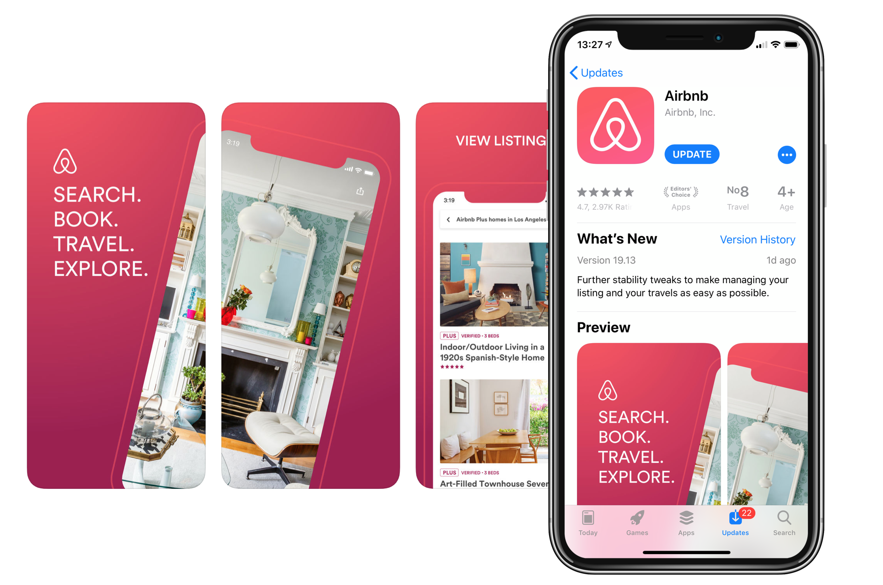

PRODUCT ROADMAP
2008 2012
FEATURES
EXPANSIONS + ACQUISTIONS
FINANCIALS
2008: Airbnb founded as AirBed & Breakfast by Brian Chesky, Joe Gebbia, and Nathan Blecharczyk
2012: Airbnb launched "Neighborhoods", a travel guide of 23 cities
2009: The name of the company was shortened to Airbnb.com
2010: Launched Airbnb Mobile app
2011: Established first international office in London
2012: 25% of users are mobile app users
2012: Airbnb acquired Urbandoor – A vacation rental market place in India
2009: Airbnb received $600,000 in seed funding from Sequoia Capital
2010: Raised $7.2 million in financing from Greylock Partners and Sequoia Capital
2011: Raised $112 million in Series A funding

Slide 5
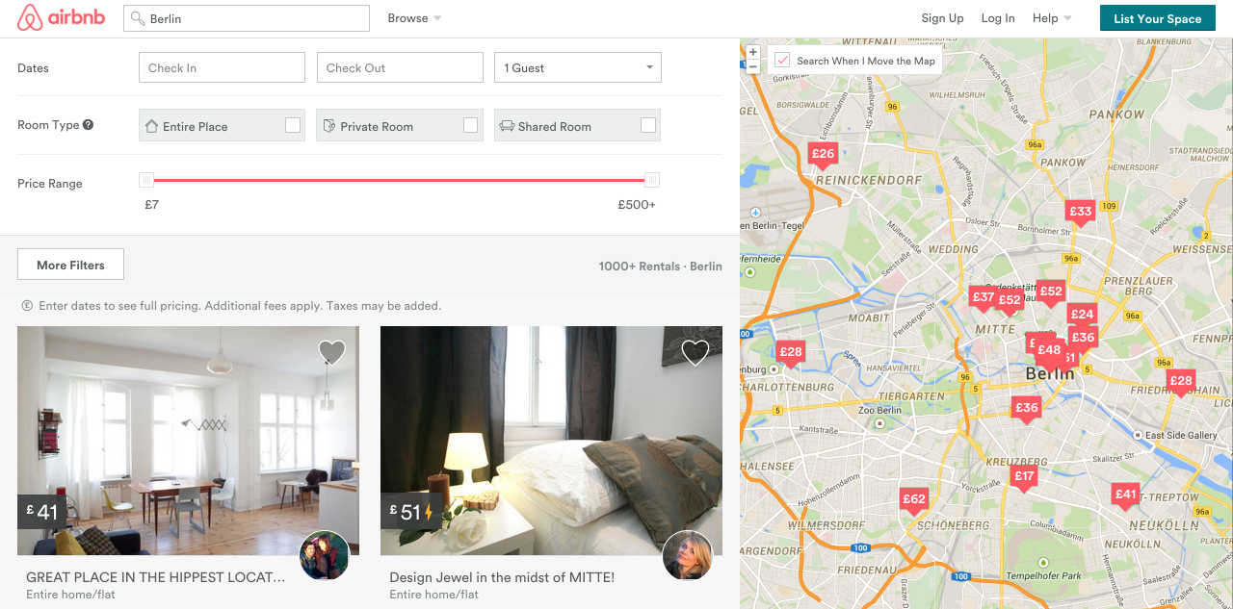


PRODUCT ROADMAP
2013 2017
FEATURES
EXPANSIONS + ACQUISTIONS
FINANCIALS
2014: The new logo, called the Bélo, was released
2015: iPad map – provides high resolution photo and interactive map Apple watch app– Increased speed of communication for users
2016: Launched "experiences", whereby users can use the platform to book activities
2017: Launched a magazine company launched Airbnbmag
2013: Airbnb had served 9,000,000 guests since its founding
2014: Announced a partnership with Concur, Business Travel Badge available
2015: Introduces Price Tips and
Smart Pricing for hosts.
2016: Led a $13 million investment in Resy
2016: Launches “Friendly Buildings Program”
2017: Airbnb acquires Tilt
2013: Airbnb raises $450 million in Series B funding.
2015: Airbnb raises $1 billion in Series C funding.
2016: Airbnb raised $555.5 million from Google Capital and Technology Crossover Ventures
2017: Raised $1 billion in funding, bringing total funding raised to more than $3 billion

Slide 6



PRODUCT ROADMAP
2018 2022
FEATURES
EXPANSIONS + ACQUISTIONS
FINANCIALS
2018: Introduces Airbnb Plus and Beyond
2021: AirCover – Free coverage for hosts
2022: Airbnb instituted a policy of unlimited remote working for almost all its employees, "Live and Work Anywhere“
2022: Launches SplitStay – Splitting a trip between two different homes in same area
2019: 2 million people were staying with Airbnb each night
2019: Acquires Gaest (Germany) and HotelTonight
2020: Became a public company via an initial public offering, raising $3.5 billion
2021: Acquires Accomon – Insurance provider for hosts in Europe
2022: Acquires rental places – Nooklyn (New York) and Tujia (China)
2019: Airbnb is fined $3 million by the city of San Francisco for violating short-term rental laws
2021: Airbnb reports $5.7 billion in revenue and hosts over 1 billion guests.
2022: $1.9 Billion profit

Slide 7
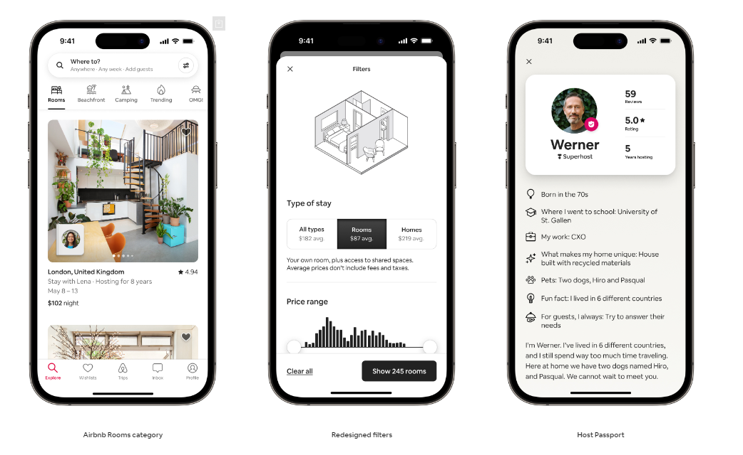
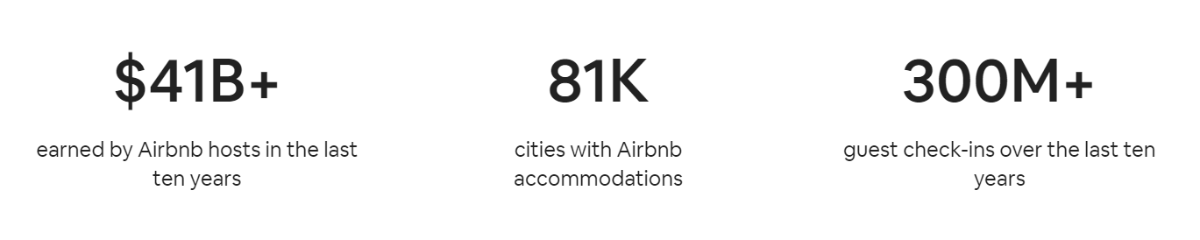
Features:
Total price display
Transparent checkout instructions
Improved maps
Redesigned wishlist
Simple and more affordable monthly stays
Priority customer service on trip
Pay over-time
Instant rebooking credit
WHATS NEXT : 2023
Airbnb Rooms Category
Redesigned Filters
Host Passport

Slide 8


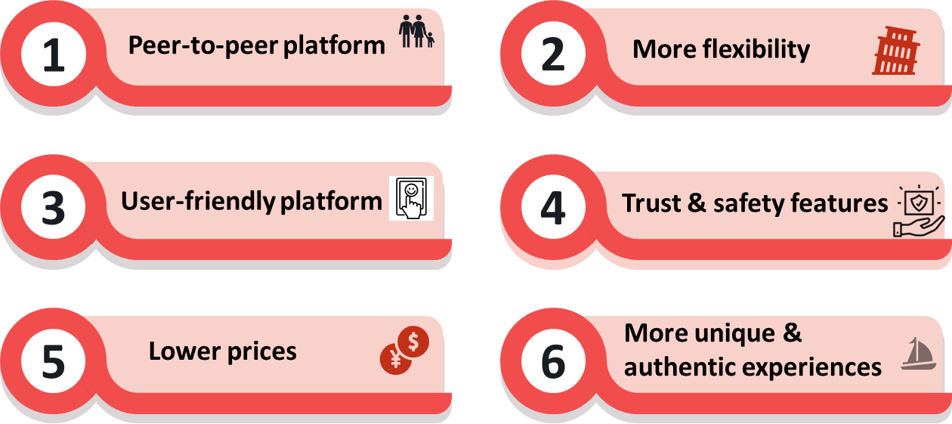

INNOVATION
Affordable Pricing

Slide 9
DISRUPTIVE INNOVATION
Challenging established hotel chains
Disrupted the value chain by disintermediation
Diversified offerings
Disruption of travel behavior
Instant bookings

Slide 10




STICKINESS
Trust and Reliability
Loyalty Programs
Trusted platform
Aircover for guests
Airbnb Plus
Airbnb Luxe
Superhost
User Experience & Personalization
Community & Social Connections
Split stays
Airbnb Experiences
Facilitating interactions
Promoting local tours

Slide 11
VALUE CREATION
Hosts
Stakeholders
Expanded affordable accommodation options​
Cultural Exchange and Local Experience​
Enhanced Flexibility​
Unique Travel experience
Travel Stipend​
Impactful work​
Innovative offices​
Employee engagement and recognition
Additional Income
Flexibility & Control
Global exposure and marketing
Safety & Trust
Feedback & Improvement
Financial Performance​
Strategic partnerships & acquisitions​
Dividend and capital allocation​
Developing local communities
Guests
Employees

Slide 12






MARKET STRATEGY
Conferences, events & Strategic Partnerships
Data-driven Approach
For Personalization
Host & Guest Experience
Competitor Data
Analysis - Craiglist
Better Digital Content
-Photos, virtual tours
Global Expansion with focus on Localization

Slide 13
MARKET TYPES
Exponential Market
Exponential growth from a mattress renting business to $78 billion market cap
Gross Booking Value (mn $)
$ 8,057 in 2015
$ 63,212 in 2022
Expanded in 220 countries capturing 26% of the market in the lodging industry
New Market
Created a new market for peer-to-peer home sharing
Affordability
Major Categories – Shared Rooms, Private Rooms, Apartments and Hotels
Adjacent Market
Launched 'Experiences' in 2016
Competitive & challenging
Future scope
Complete Itinerary
Rental Cars
Food Delivery
Flights

Slide 14
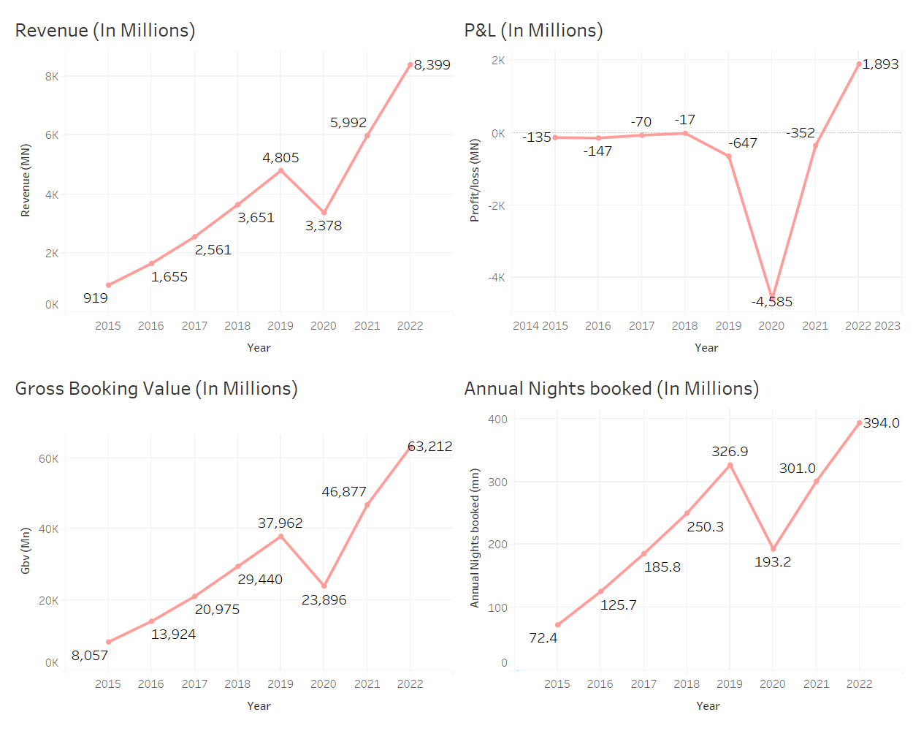
FINANCIALS
Revenue Growth shows the CAGR of 31.36%
Gross booking value shows CAGR of 29.36%
Annual Nights booked Shows 23.67%
For the year 2022 ,The Audited balance sheet shows total Asset of $16,083 Million on which ROI comes to 11.8%.
In 2022, Company Reported first time profit After getting listed.

Slide 15





COMPETITORS
Online Travel Agencies
Internet search engines
Property management companies
Listing and meta search websites
Hotels

Slide 16
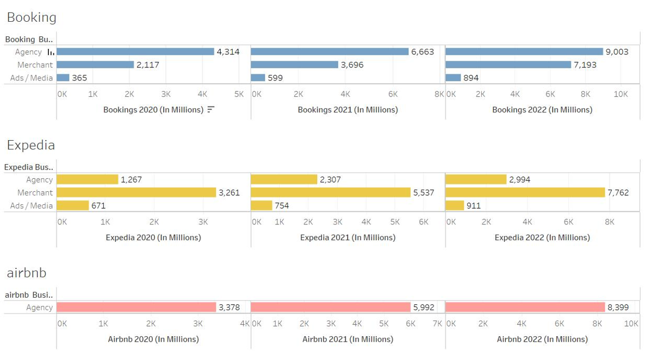
COMPARING REVENUE

Slide 17



CRITICAL APPRECIATION
Positive Impact
Promote staycation
Boost tourism in underexplored areas
Supporting local economies
Revenue generation
Negative Impact
Long term effect on housing market
Reduced accountability
Area for Improvement
Customer helpline
Property listing and marketing
Host and Guest reviews

Slide 18

REFERENCES
https://www.sec.gov/ix?doc=/Archives/edgar/data/0001559720/000155972023000003/abnb-20221231.htm
https://seekingalpha.com/article/4559301-airbnb-a-revolutionary-company-set-to-outperform-the-market
https://www.sec.gov/Archives/edgar/data/1559720/000119312520294801/d81668ds1.htm#toc81668_9
Airbnb - Wikipedia
https://www.youtube.com/watch?v=16cM-RFid9U
2022 Airbnb strategy | Rental Scale-Up (rentalscaleup.com)
Airbnb Unveils Roadmap to Bring Magical Travel to Everyone
https://www.sec.gov/ix?doc=/Archives/edgar/data/0001324424/000132442423000007/expe-20221231.htm
https://www.sec.gov/ix?doc=/Archives/edgar/data/0001075531/000107553123000016/bkng-20221231.htm
https://www.rentalscaleup.com/airbnb-2022-summer-update-release/

Slide 19
THANK YOU

